Slide 1
TutorHelper
Wilson Sue, Cyrus Villaruz, Elijah Fabon, Jaiden Duncan

Slide 2
Problem Statement: As students we have trouble studying or learning about certain subjects
Solution: TutorHelper is meant to assist us in our studies using fact checked guardrailedd AI with extensive prompting

Slide 3
Demo

Slide 4
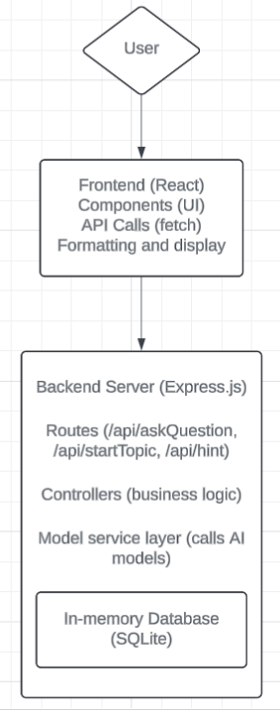
Architecture

Slide 5
Tech Stack
Frontend | Backend
React | Express.js
MaterialUI | Sqlite3
 | HF Inference Providers
 | Google AI Studio

Slide 6
Technical Challenges and Solutions
Learning new technology frameworks, and tools.
Difficulty connecting client and server features
Getting the right output from the AI models
Frequent HuggingFace API key generation

Slide 7
Compromises
Scrapped file uploading and visual maps due to scale and dev pacing
ADHD focused learning methods (eg, calendar, timer)
Changed learning-type detection to user-selected learning type

Slide 8
Main
Challenges
Meaningful discussions or meetings
Overestimating our time constraint
Code compatibility checks when merging into main, causing unnecessary refactoring
Not enough pushing of features - main cause of conflicts

Slide 9
Lessons Learned
Get to the main point in meetings
Update the README.md often
Check-in with members before pushing
Test features and bug fixes in smaller increments instead of big chunks

Slide 10
Thank You for listening

